Slide 1
Fundamentals of Remote Sensing
L2 - Electromagnetic radiation
for remote sensing specialists

Slide 2
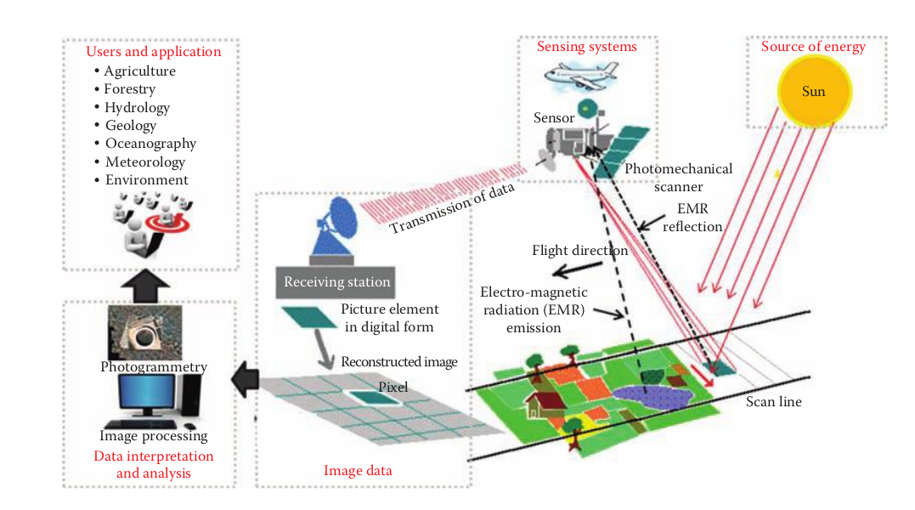

Slide 3
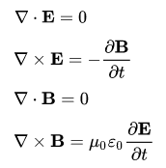
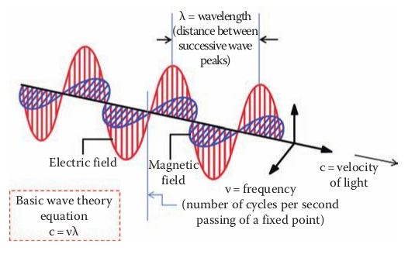



Electromagnetic wave
Wave solution of Maxwell’s equations - synchronized oscillations of electric and magnetic fields that propagate at the speed of light.
EMR - Electromagnetic Radiation
https://en.wikipedia.org/wiki/Electromagnetic_radiation

Slide 4

Key EMR properties
:
1) frequency, wavelength
2) transmission direction
4) polarization
3) amplitude, power

Slide 5


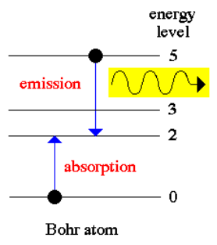
EMR. Quantum properties
EMR intimately related to atomic structure and energy
Quantum theory says that EMR consists of photons, uncharged elementary particles with zero rest mass which are the quanta of the electromagnetic force
Photon Energy :
Photon Momentum :

Slide 6
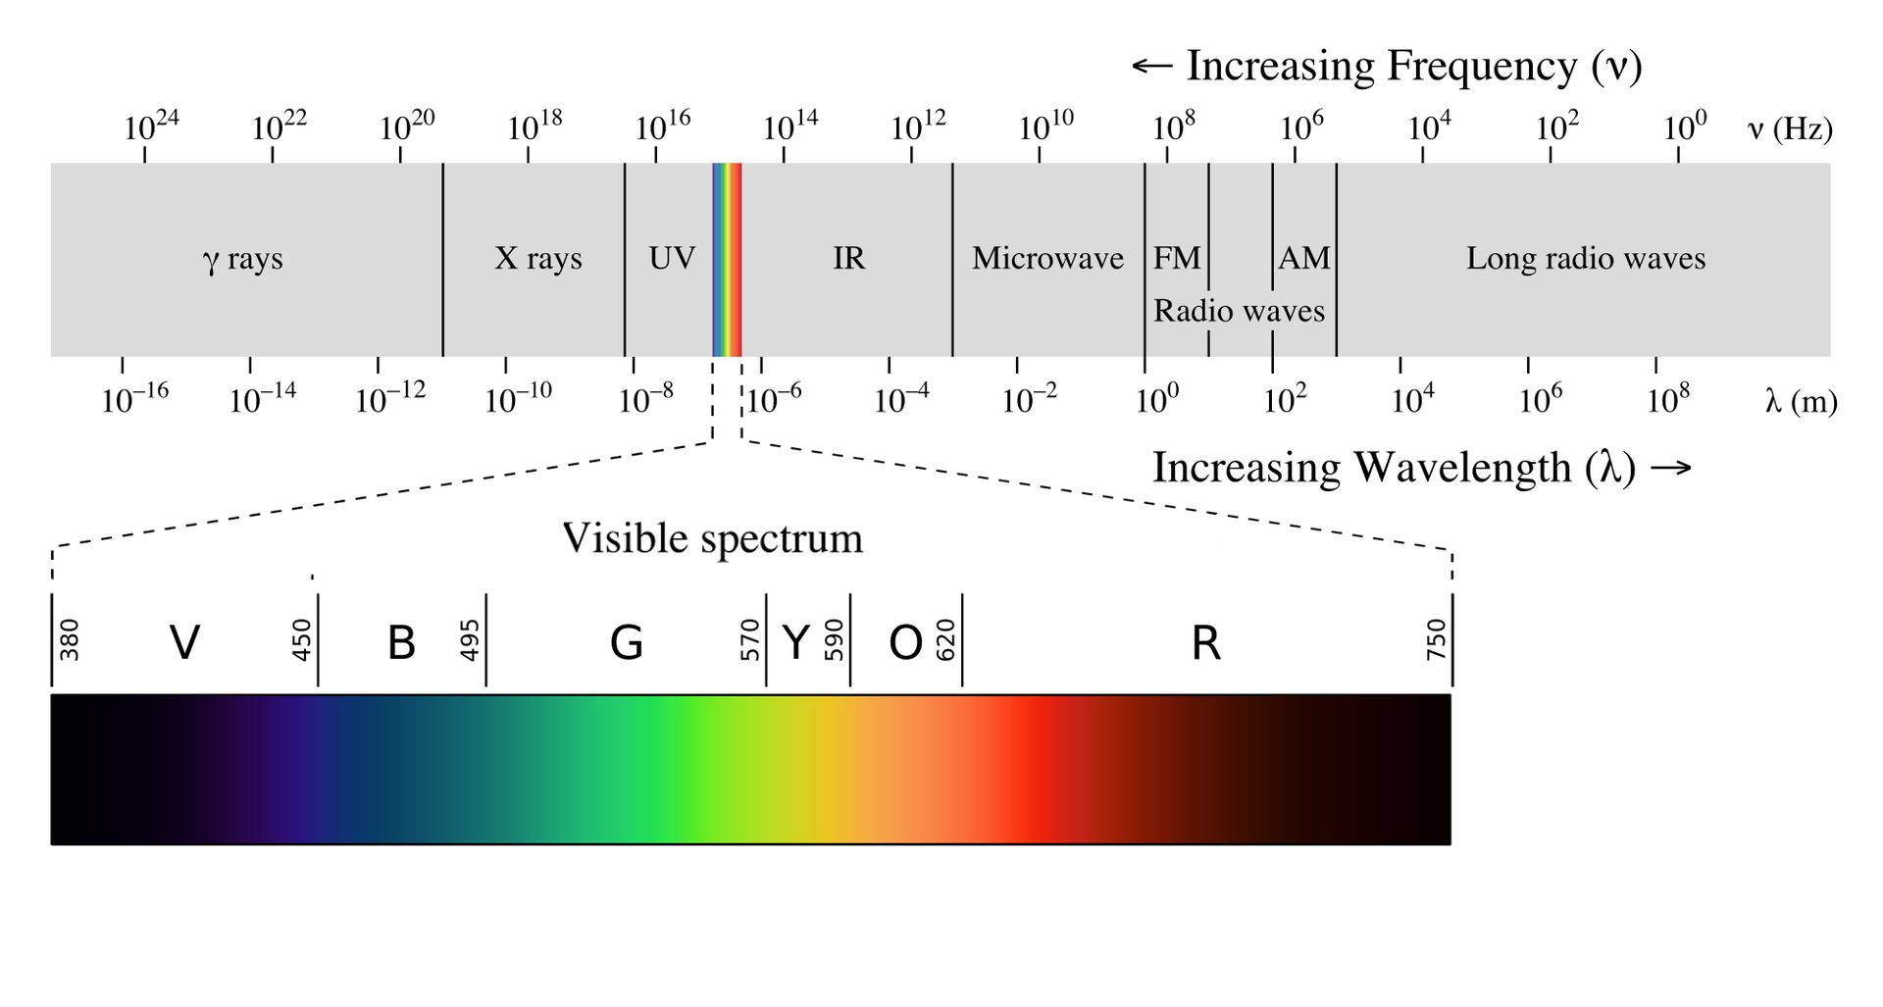
EMR. Frequency Spectrum (EMS)

Slide 7
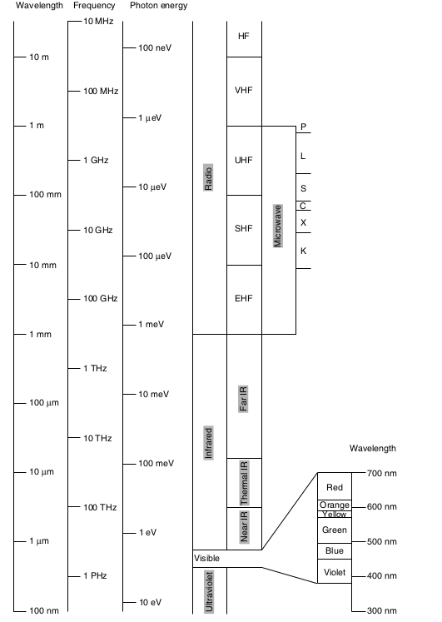
EMR. Spectrum

Slide 8
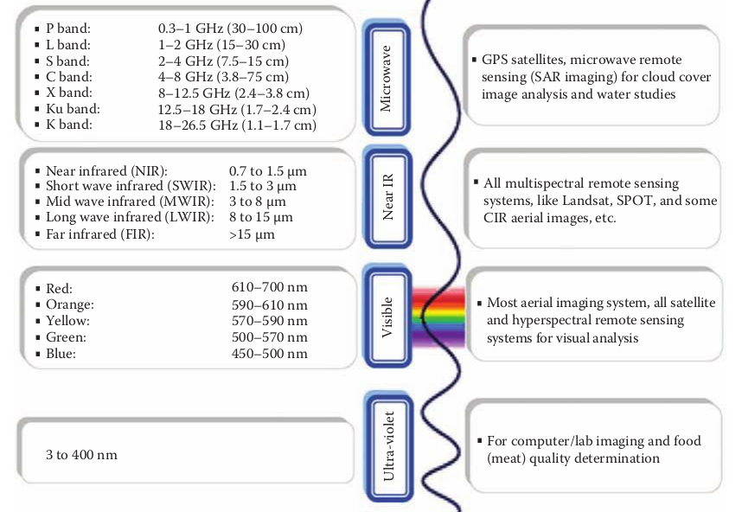
EMR. Spectrum

Slide 9
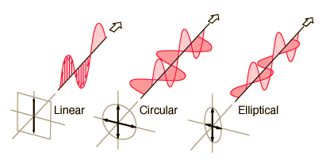
EMR. Polarization
by convention, the "polarization" of electromagnetic waves refers to the direction of the electric field.
In linear polarization, the fields oscillate in a single direction.
In circular or elliptical polarization, the fields rotate at a constant rate in a plane as the wave travels
https://en.wikipedia.org/wiki/Polarization_(waves)

Slide 10
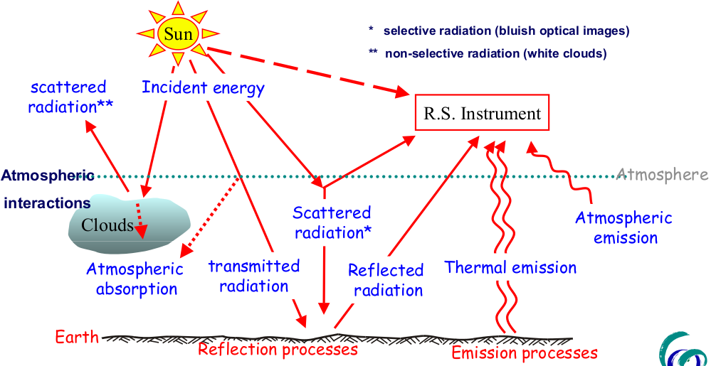

Slide 11
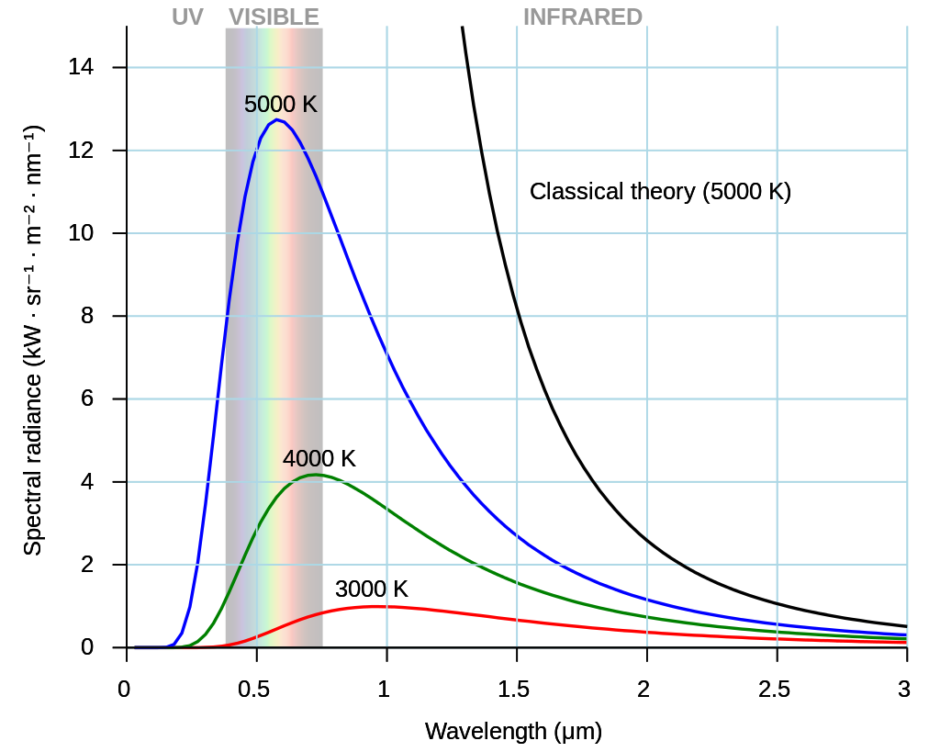

Black body radiation
All normal matter emits and absorbs electromagnetic radiation. An object that absorbs all radiation falling on it, at all wavelengths, is called a black body.
Planck's law of black-body radiation
Bν(T) is the spectral radiance (the power per unit solid angle and per unit of area normal to the propagation) density of frequency ν radiation per unit frequency at thermal equilibrium at temperature T.
H - the Planck constant;
c - the speed of light
k - Boltzmann constant;
ν - frequency ;
T - absolute temperature of the body.

Slide 12
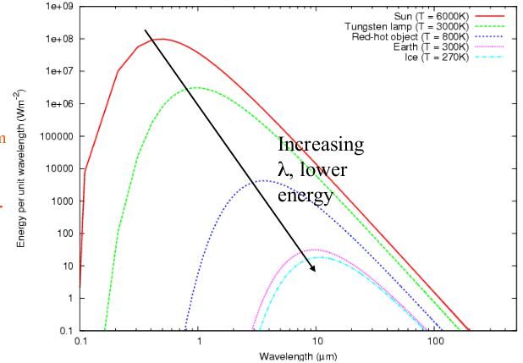



Plank’s law consequences
Wien's displacement law
wavelength at which the intensity per unit wavelength of the radiation produced by a black body is at a maximum, λ max , is a function only of the temperature
Where b - Wien’s displacement
constant = 2.8978×10-3 K * m
* peak of sunʼs energy around 0.5 μm
* peak of Earthʼs energy around 10 μm
Stefan–Boltzmann law
Total emitted radiation from a blackbody, in Wm ⁻²
Stefan–Boltzmann constant:

Slide 13
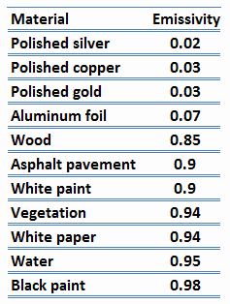
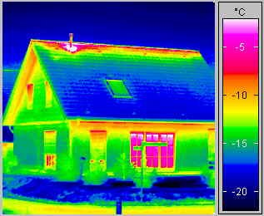
Raditation. Emissivity
Real objects never behave as full-ideal black bodies, and instead the emitted radiation at a given frequency is a fraction of what the ideal emission would be. Emissivity is defined as the ratio of the energy radiated from a material's surface to that radiated from a blackbody (a perfect emitter) at the same temperature and wavelength and under the same viewing conditions

Slide 14
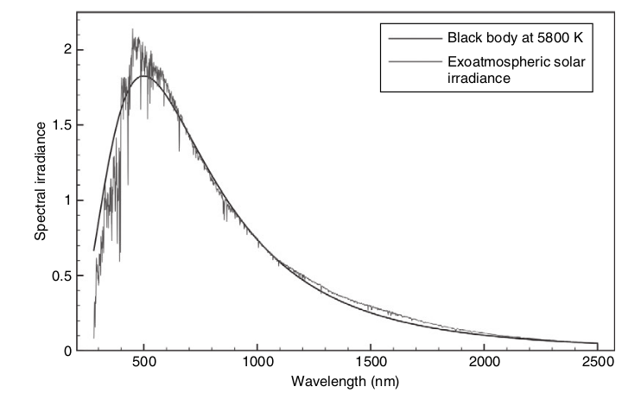
Sun radiation
~1373Wm⁻² at top of atmosphere (TOA)

Slide 15
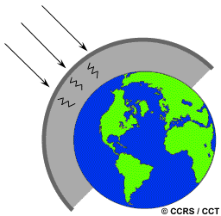
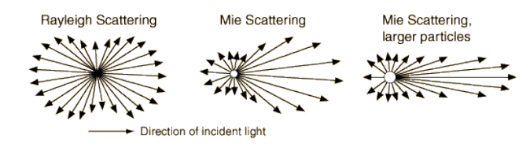
Atmospheric scattering
1: Rayleigh scattering Particle size << λ of radiation
• e.g. very fine soot and dust or N ₂ , O ₂ molecules
• Rayleigh scattering dominates shorter λ and
in upper atmos. ∝ λ -4 so scattering
of blue light (400nm) > scattering of red light (700nm)
2. Mie scattering Particle size ≈ λ of radiation
- dust, pollen, smoke and water vapor
- weak dependence on λ
3: Non-selective scattering. Particle size >> λ of radiation
- All λ affected about equally
- “white” scattering, fog, clouds

Slide 16
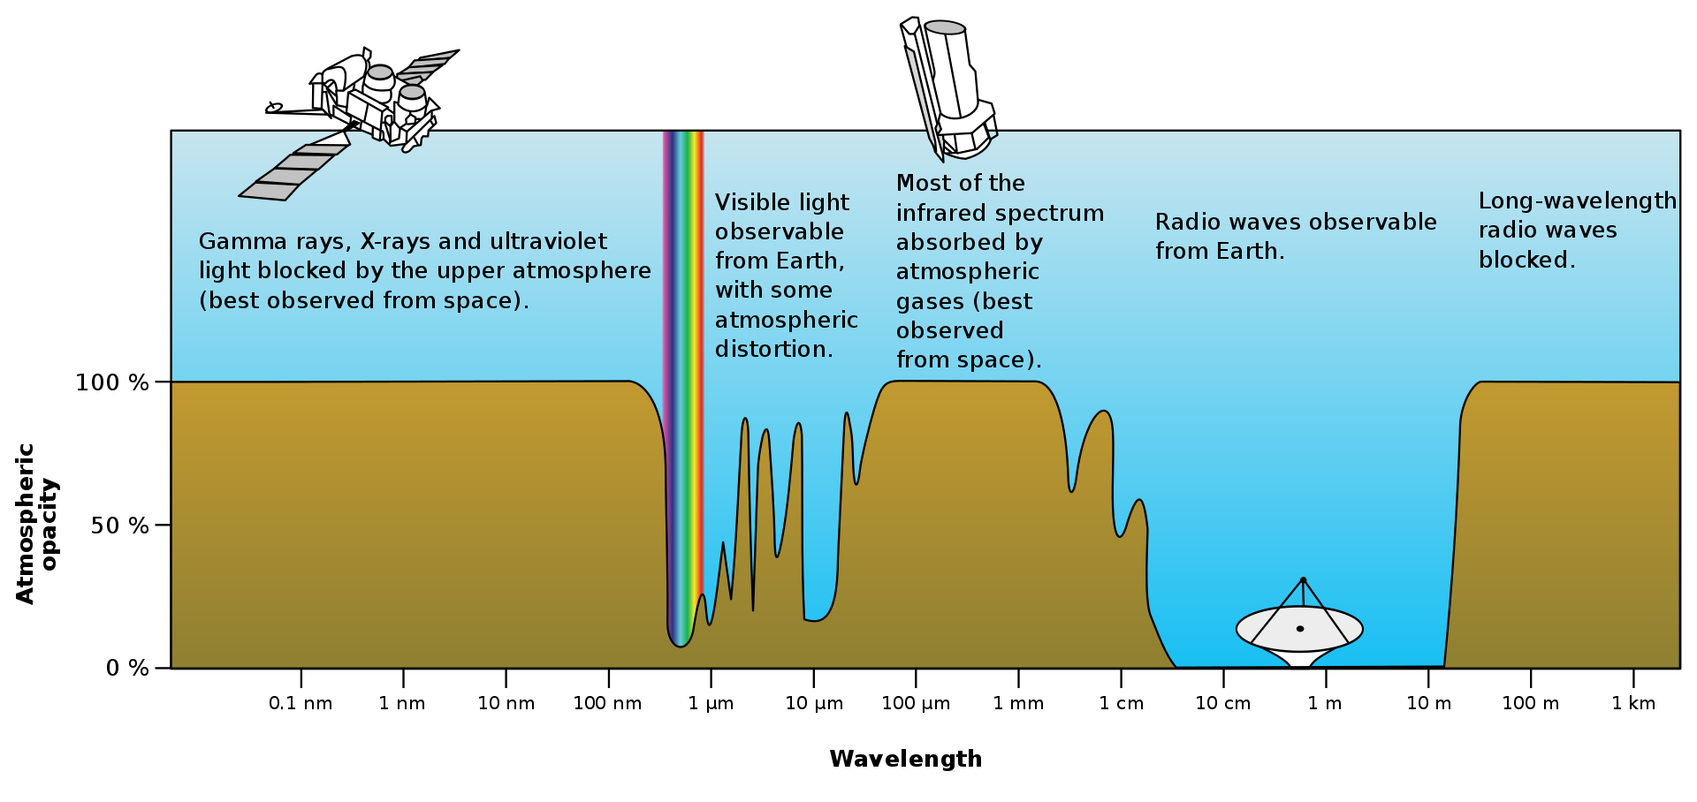
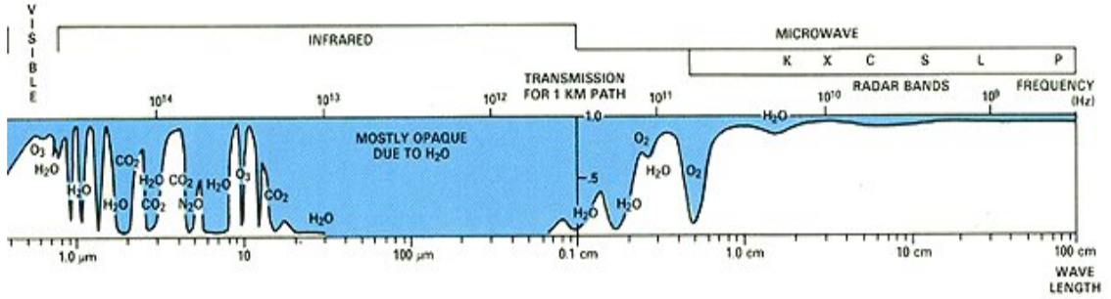
Atmospheric absorbtion & transmission
– windows, roughly: 400-750, 800-1000, 1150-1300, 1500-1600, 2100-2250nm

Slide 17
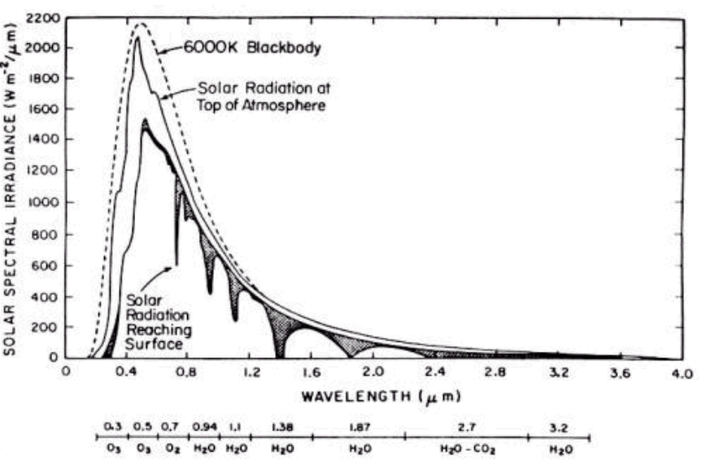
Radiation reaching Earth surface

Slide 18
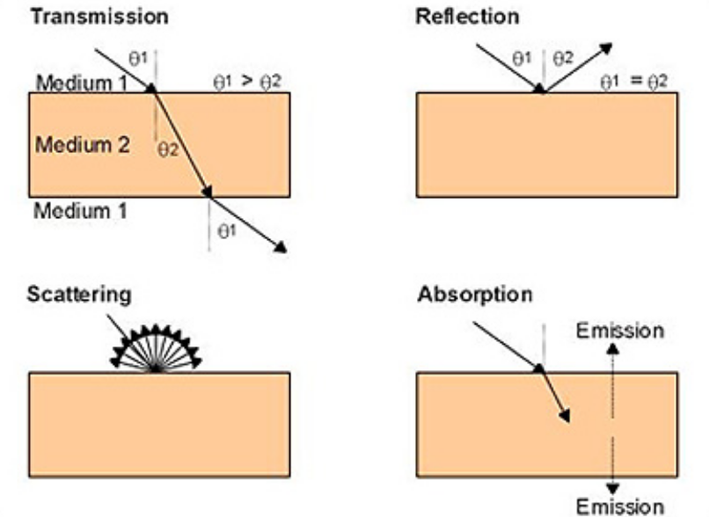
Radiation – target interaction

Slide 19

Interaction with surface
Total amount of radiant flux per wavelength incident on surface, Φ(λ) Wμm ⁻¹ is summation of:
• reflected R _{λ} ,
transmitted T _{λ} ,
absorbed, A _{λ}
• i.e. Φ(λ) = R _{λ} + T _{λ} + A _{λ}

Slide 20
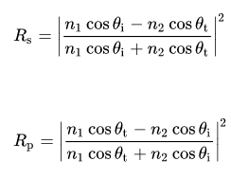
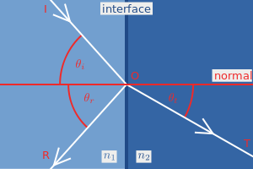
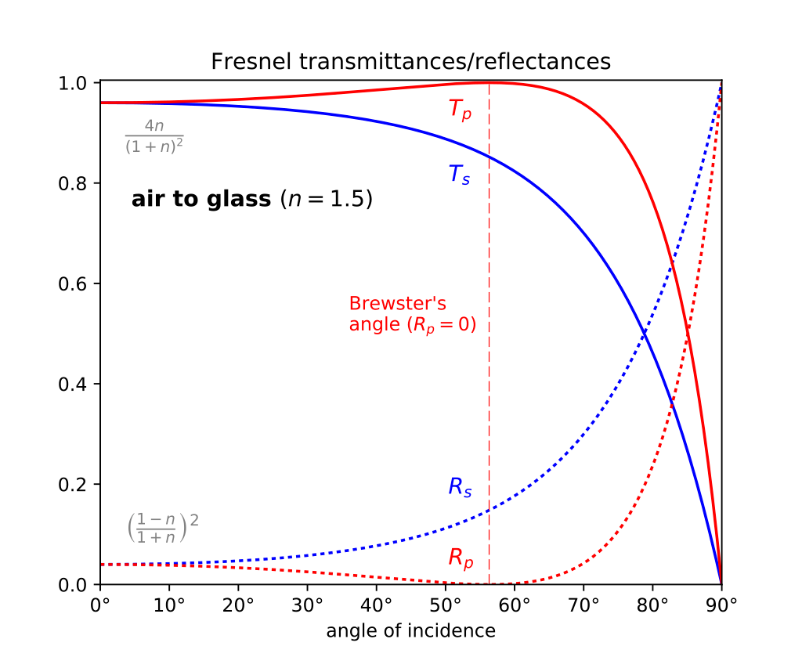
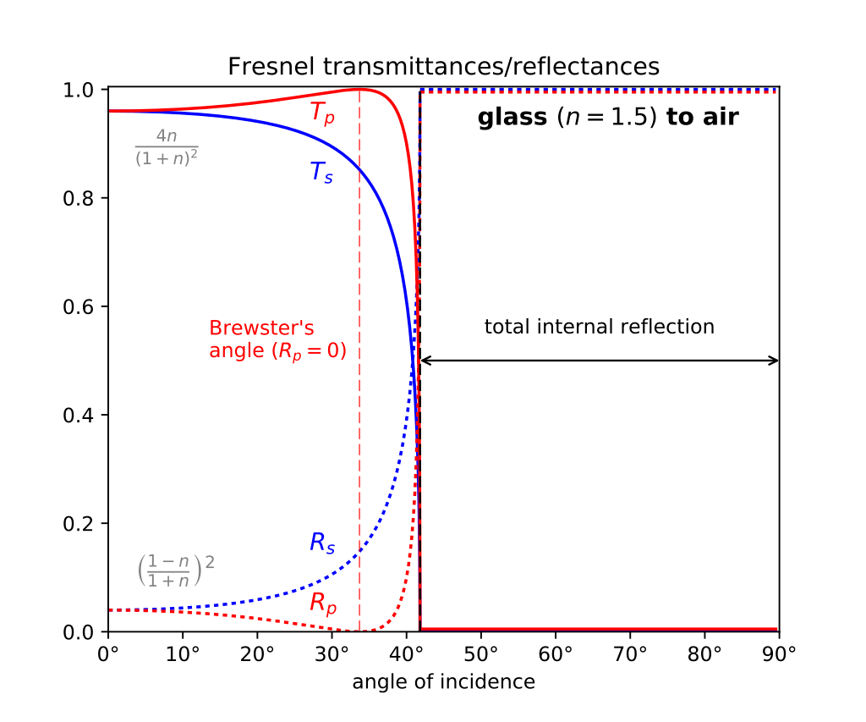
Fresnel equations
The orientation of the incident light's polarization with respect to the plane of incidence has an important effect on the strength of the reflection. P-polarized light is incident linearly polarized light with polarization direction lying in the plane of incidence. S-polarized light has polarization perpendicular to the plane of incidence

Slide 21
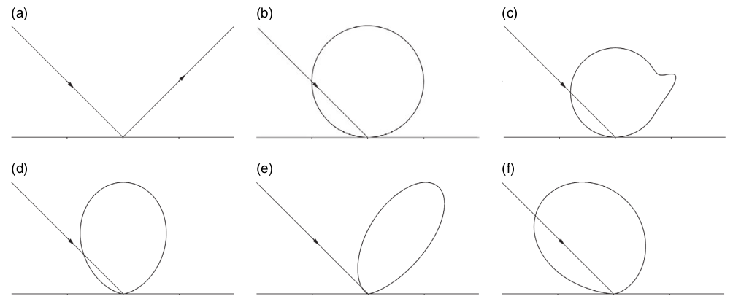
Reflection. Angular dependency
Lambertian reflectance is the property that defines an ideal "matte" or diffusely reflecting surface. The apparent brightness of a Lambertian surface to an observer is the same regardless of the observer's angle of view.
Specular reflection
Lambertian
quasi-Lambertian
Forward scattering
Back scattering

Slide 22
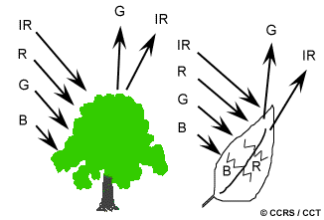
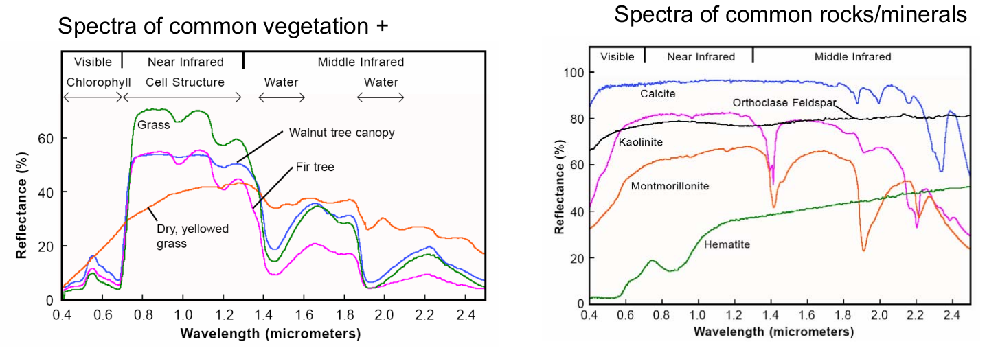
Reflection. Wavelength dependency
Spectral reflectance, ρ(λ), defined as ratio
of incident flux to reflected flux at same
wavelength
• ρ(λ) = L(λ)/I(λ)

Slide 23
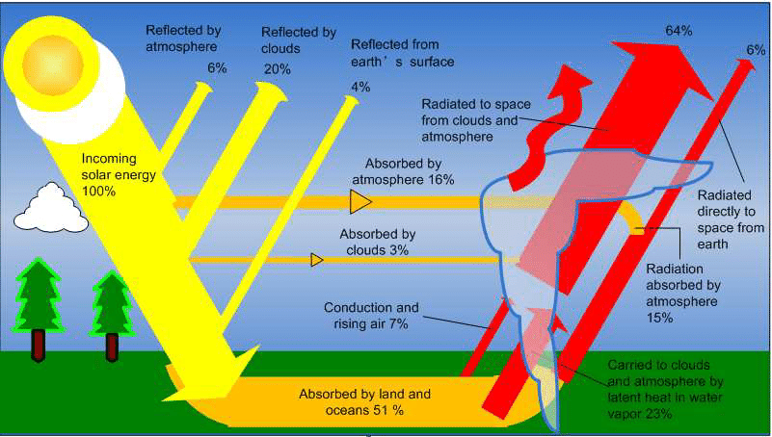
Earth energy budget

Slide 24
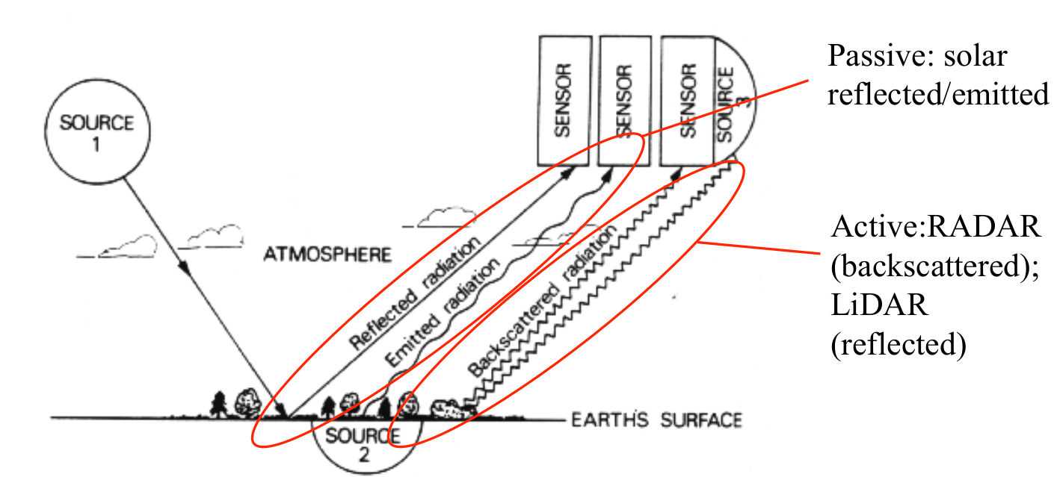
Radiation in remote sensing
Passive and active sensors

